Slide 1
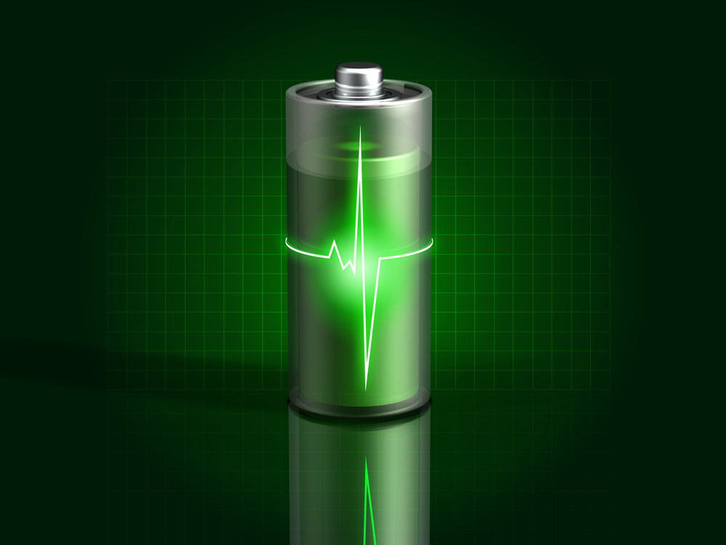
Electric Vehicle Charging Station
Hamzah Abeer
Abdulaziz Almarzouqi
Nick Riesberg
Derek Schmitz
Matt Stobb
Brandon Umscheid
Group: May13-22A
Client: Paragon
Advisor: Dr. Bigelow
Notes:
In the second meeting, you will have to make a short presentation -- about 10-20 minutes -- with slides and satisfying all of the following 9 requirements, simultaneously:
1. All team members have to present something.
2. No intro and no ending are necessary (skip introduction of team and team members, time schedule, budget, etc.)
3. The presentation will clearly state the scope of the project (try to explain this coherently, in simple terms -- main ideas and intuition behind them).
4. The presentation will clearly state the current design (block diagrams, pictures, etc. should be included). If you believe this is the weak point of your project, you will have to work hard demonstrate some design component.
5. The presentation will clearly state how you have reached the current design (explain the process of design) and how the project progressed so far.
6. The presentation will point out from 2 to 5 technical challenges you have encountered during the project design and/or implementation, and the brilliant solutions you found to overcome these challenges.
7. The presentation will show the existence of a coherent test plan which was (or still is) carried out. This will demonstrate that you approached the problem in a systematic manner.
8. You must show that you have thought of all possible scenarios when producing the design, and that you have prepared for all impossible scenarios by designing a good testing and debugging plan.
9. The presentation will have a clear story line (narrative), and should flow well. Try to make connections between different phases of the presentation, so that the transitions are smooth.
Try to stick to light-colored backgrounds (light colored backgrounds look better on large screens -- like the projector you will use during the final IRP presentation, so try to stick to that starting now.) Make sure your presentation has enough contrast (no yellow writing on white background).
Make sure your presentation is either PDF or is run on the cloud, so that it looks the same on any machine (no ppt -- just convert to PDF and play PDF slide show).
For this second meeting, you will have to present using your own machine (please do not bring me memory sticks).

Slide 2
Our Mission
Working with multi-disciplinary group to build an electric vehicle.
Our task is to build a battery charger to recharge batteries for low voltage vehicles.
Presenter: Matt Stobb

Slide 3

Based in Nevada, IA
Family-owned company that started out making popcorn machines years ago
Markets in 43 countries
Main retail is concession stands and supplies
http://www.manufacturedfun.com/
Presenter: Matt Stobb

Slide 4
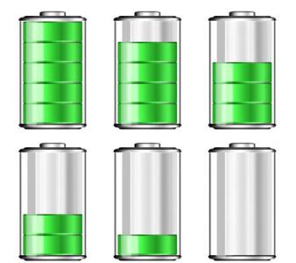
Requirements
Rate of Charge must be at maximum 6-8 hours to reach full capacity
The Charging Station must be designed will all current standards
Charger maintains battery life for 3-5 years
State of Charge (SOC) indicator
Two Interfaces
  Graphical User Interface
  LCD Interface
Presenter: Matt Stobb

Slide 5
Safety Concerns
Testing/Safety
Electrical
Over-Volt/ Under-Volt
Over-Charge
Environmental
Water
Human
Thermal Overload
Dust
Electrostatic Discharge
Physical Damage
Connection Errors
Presenter: Matt Stobb

Slide 6

Standards
2011 National Electrical Code
SAE Technical Standards
IEEE Standards
Presenter: Derek Schmitz

Slide 7
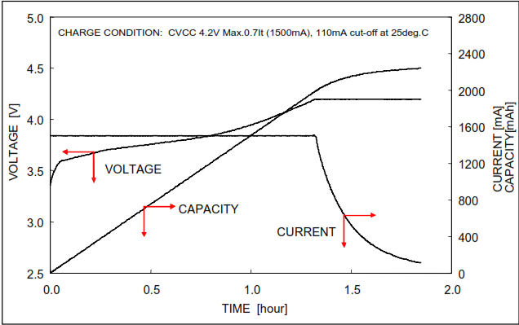
How the Batteries Charge
Charges at constant current then switches to constant voltage.
Allows ability to charge Lithium Ion and Lead Acid.
Presenter: Nick Riesberg

Slide 8
Technical Challenges
High Currents
Temperature/Heat Dissipation
Ripple Current and Voltage
Presenter: Nick Riesberg

Slide 9
Components
Solid State Relay
Rectifier
Buck Converter
Current and Voltage Sensors
Microcontroller
Bluetooth
LCD Interface
Presenter: Nick Riesberg

Slide 10
Electric Wiring Diagram
Presenter: Brandon Umscheid

Slide 11
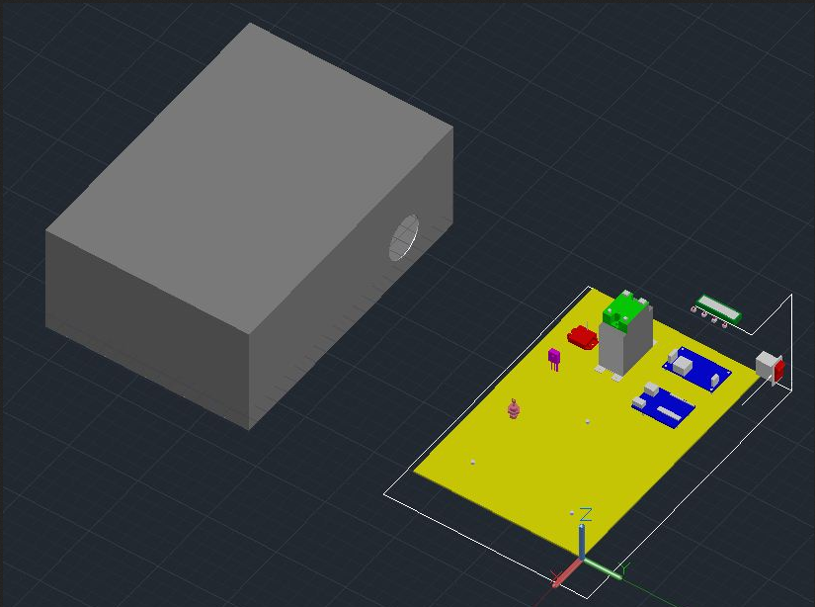
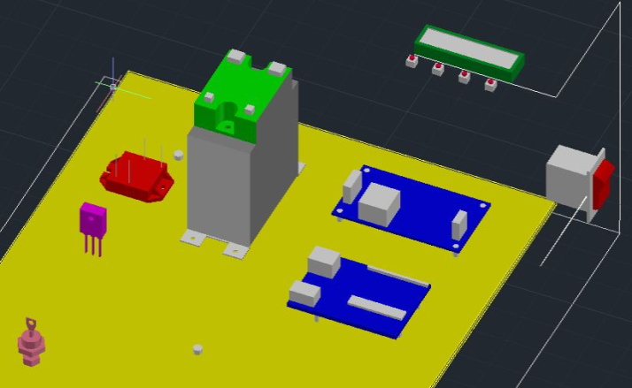
System Concept Model:
Presenter: Brandon Umscheid

Slide 12
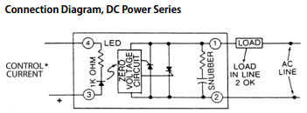
Circuit Shut Off
Using a Solid State Relay (SSR) for the shut off.
Uses a DC voltage sent from the micro-controller to be an On/Off switch.
Has a built in snubber to help prevent unwanted turn on.
Presenter: Brandon Umscheid

Slide 13
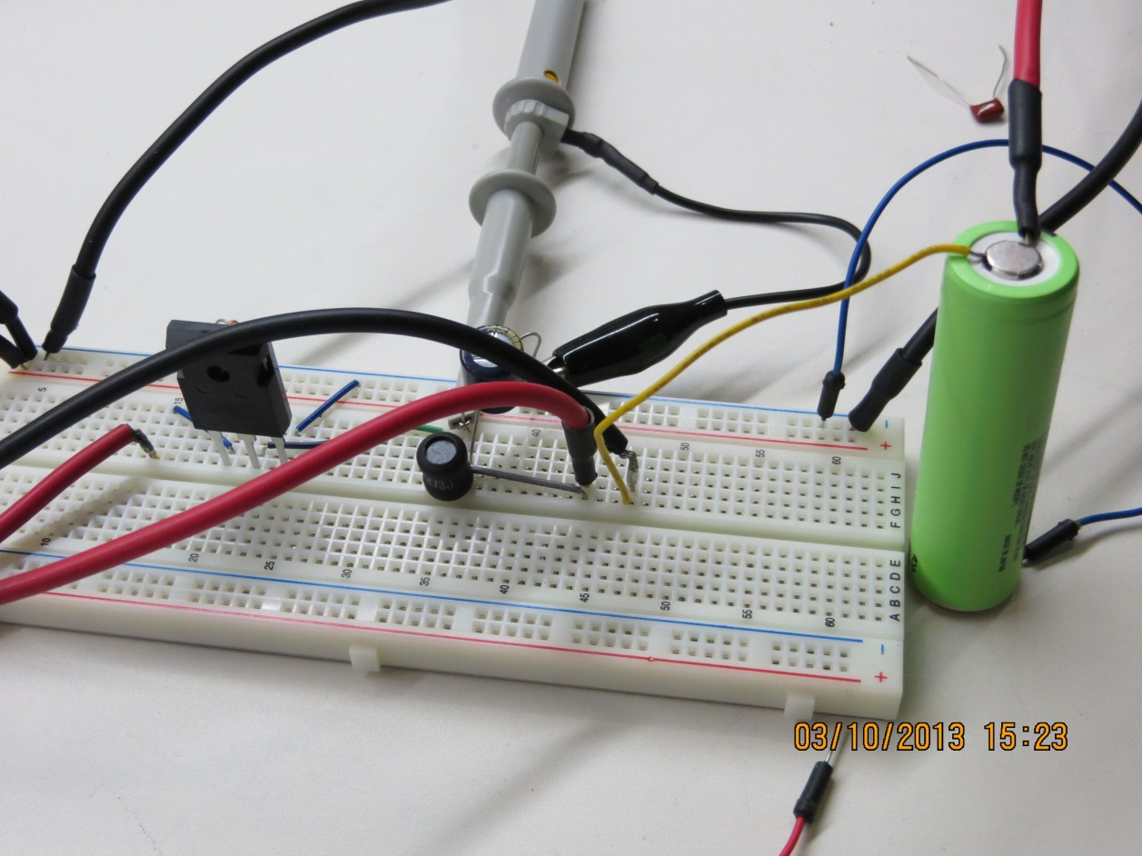
Buck Converter Testing
Presenter: Derek Schmitz

Slide 14
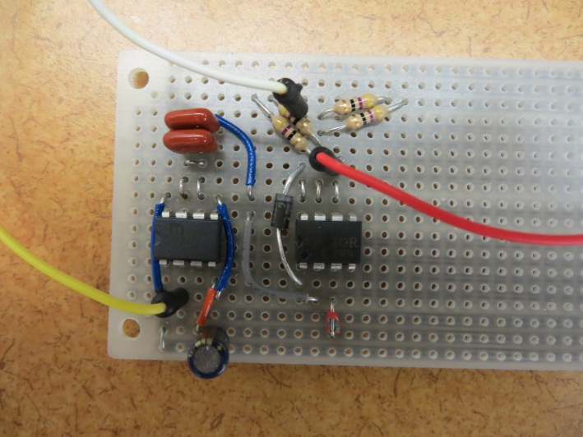
Scaling Problems
Problem: When charging higher voltage systems gate voltage must be greater than source voltage.
Solution: Introduce a gate drive circuit that keeps gate voltage higher than source voltage during on time of PWM signal.
Presenter: Derek Schmitz

Slide 15
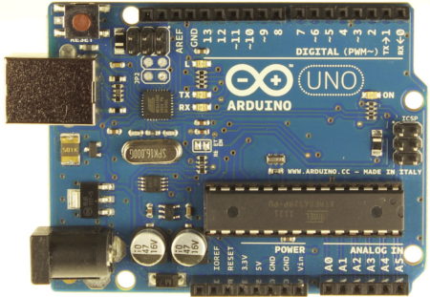
Arduino Uno R3
16Mhz
14 Digital pins
6 Analog pins
Open source
Low-Cost
Presenter: Hamzah Abeer

Slide 16
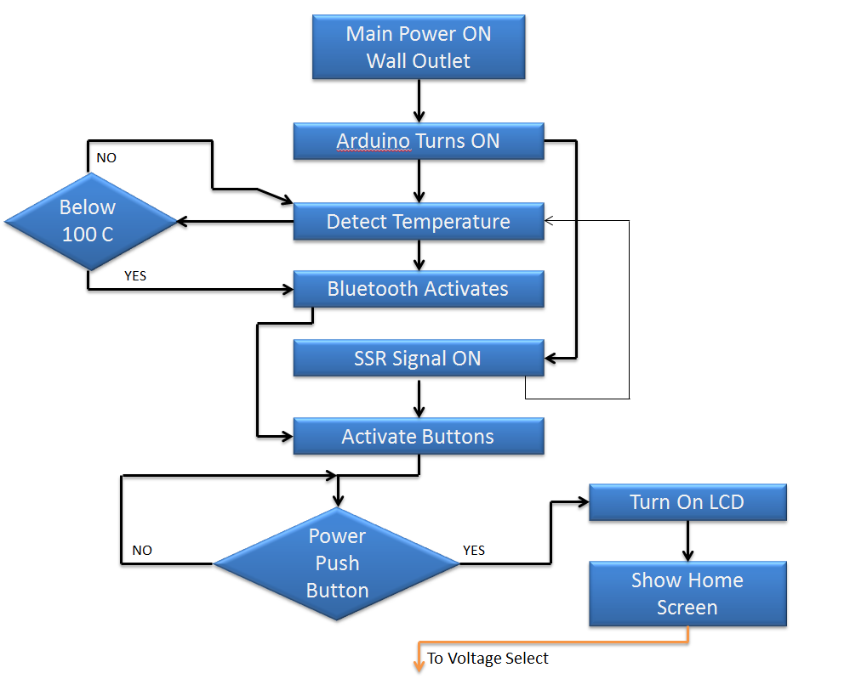
Process Map
Presenter: Hamzah Abeer

Slide 17

Display Outputs
32 Character LCD
4-Push buttons
Up, down, right, left
Presenter: Hamzah Abeer

Slide 18
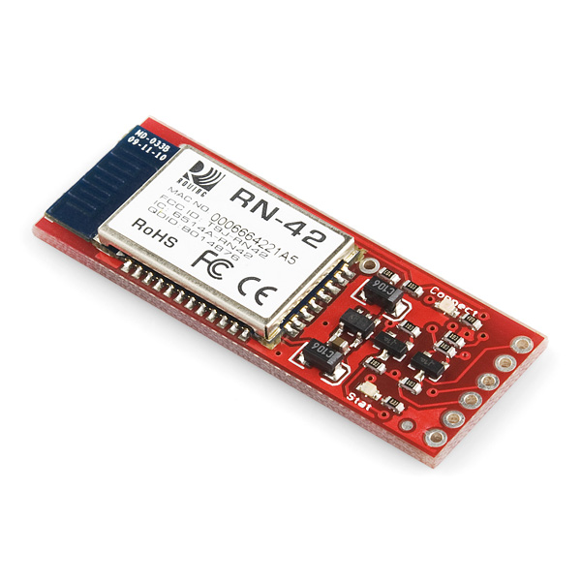
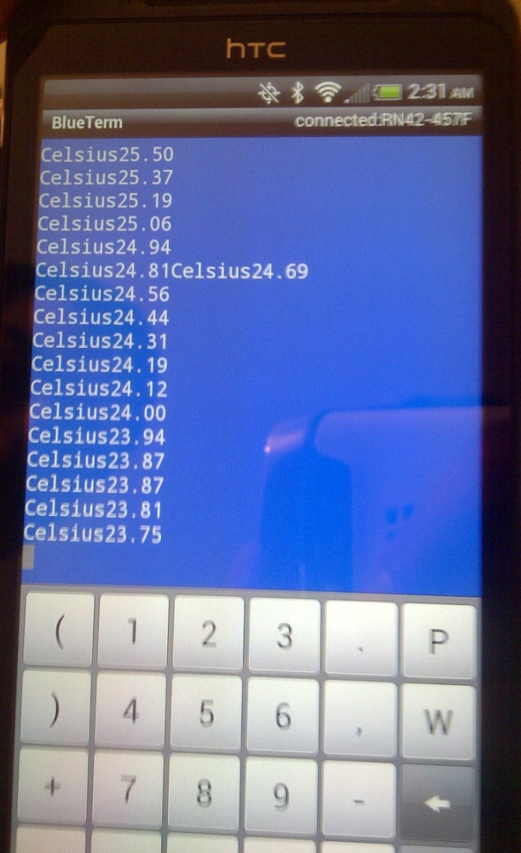
Bluetooth ( Sparkfun Silvermate)
Serial communications: 2400-115200bps
Built-in antenna
FCC Approved
Presenter: Abdulaziz Almarzouqui

Slide 19

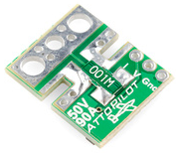
Sensors
Temperature Sensor
Voltage/Current Sensor
Location on circuit:
Connected with microcontroller
In line with battery
Location on Circuit:
Connects Directly to Microcontroller
DS18B20
1-Wire interface
9 to 12 bit precision
Temp. Measure: -55⁰ C to 125⁰ C
Sen-09028
Small voltage and current sensor PCB
Measured over shunt resistors.
Scaled to a 5V ADC
Presenter: Abdulaziz Almarzouqui

Slide 20
Possible Future Improvements
Reduce/Replace Arduino.
Replace/Remove Bluetooth Device.
Embed all components.
Replace Solid-State Relay with TRIAC controlled system.
Design and fabricate a custom casing with ventilation.
Setup System to handle higher voltages.
Presenter: Derek Schmitz

Slide 21
Questions?
Website: isuevcs.weebly.com

